Slide 1




Write Antifragile & Domain-Driven Tests with
QA
Smoke tests Exploratory tests End-to-end tests
Outside-in diamond TDD
contract tests
Integration tests
Acceptance tests
(Coarse-grained “unit” tests)
Thomas PIERRAIN @tpierrain (υѕe caѕe drιven)
unit tests
(Fine-grained)
THOMAS PIERRAIN (@TPIERRAIN)
Notes:
It’s one of my fav topic

Slide 2
Disclaimers
There is no silver bullet Your testing strategy & techniques must always be chosen accordingly to your context (both human & technical)
As long as you can understand & explain your trade-offs there is no reason not to explore new paths…
Thanks to Kent Beck, Martin Fowler, Michael Feathers, Nat Pryce & Steve Freeman for their great source of inspiration over the years #shouldersOfGiants
Notes:
After more than 15 years of TDD practice, we are describing here a testing strategy (outside-in diamond) that works amazingly well in many of our contexts (clients, domains , teams, cultures)

Slide 3



Test Driven
development
ET
Exploratory Tests (E2E)
IT
Integration Tests (Contract)
AT
(coarse-grained unit) Acceptance Tests
Tests?
THOMAS PIERRAIN (@TPIERRAIN)
UT
(fine-grained) Unit Tests

Slide 4
Why
Test Driven
development
Baby steps eradicate Procrastination and premature optimizations
Less debugging with Live testing tools
No regression
More relaxed
More efficient
More relevant
THOMAS PIERRAIN (@TPIERRAIN)
YAGNI ( Outside-in form )
Shared and clarified mental models
Notes:
Premature optimization: Split the make it work and the make it better
YAGNI: focus only on what really matter.
More relaxed – Against Procrastination and premature optimizations
More efficient – Progressive consolidation with baby steps
More relevant – Outside-in embraces YAGNI
Image: https://miro.medium.com/max/13440/1*o7WmwGkLVR0dVQUYqfSBeg.jpeg

Slide 5
Outside-in
Test Driven
development
THOMAS PIERRAIN (@TPIERRAIN)
Notes:
Image: https://miro.medium.com/max/13440/1*o7WmwGkLVR0dVQUYqfSBeg.jpeg

Slide 6
Outside-in
Test Driven
development
AT
THOMAS PIERRAIN (@TPIERRAIN)
Notes:
Image: https://miro.medium.com/max/13440/1*o7WmwGkLVR0dVQUYqfSBeg.jpeg

Slide 7
Outside-in
Test Driven
development
AT
THOMAS PIERRAIN (@TPIERRAIN)
Notes:
Image: https://miro.medium.com/max/13440/1*o7WmwGkLVR0dVQUYqfSBeg.jpeg

Slide 8
Outside-in
Test Driven
development
AT
AT
THOMAS PIERRAIN (@TPIERRAIN)
Notes:
Image: https://miro.medium.com/max/13440/1*o7WmwGkLVR0dVQUYqfSBeg.jpeg

Slide 9
Outside-in
Test Driven
development
AT
AT
AT
THOMAS PIERRAIN (@TPIERRAIN)
Notes:
Image: https://miro.medium.com/max/13440/1*o7WmwGkLVR0dVQUYqfSBeg.jpeg

Slide 10
Outside-in
Test Driven
development
AT
AT
AT
AT
THOMAS PIERRAIN (@TPIERRAIN)
Notes:
Image: https://miro.medium.com/max/13440/1*o7WmwGkLVR0dVQUYqfSBeg.jpeg

Slide 11
Outside-in
Test Driven
development
AT
AT
AT
AT
AT
THOMAS PIERRAIN (@TPIERRAIN)
Notes:
Image: https://miro.medium.com/max/13440/1*o7WmwGkLVR0dVQUYqfSBeg.jpeg

Slide 12
Outside-in
Test Driven
development
AT
AT
AT
AT
AT
AT
THOMAS PIERRAIN (@TPIERRAIN)
Notes:
Image: https://miro.medium.com/max/13440/1*o7WmwGkLVR0dVQUYqfSBeg.jpeg

Slide 13
Outside-in
Test Driven
development
AT
AT
AT
AT
AT
AT
AT
THOMAS PIERRAIN (@TPIERRAIN)
Notes:
Image: https://miro.medium.com/max/13440/1*o7WmwGkLVR0dVQUYqfSBeg.jpeg

Slide 14
Inside-out
Test Driven
development
THOMAS PIERRAIN (@TPIERRAIN)
Notes:
Image: https://miro.medium.com/max/13440/1*o7WmwGkLVR0dVQUYqfSBeg.jpeg

Slide 15
Inside-out
Test Driven
development
UT
THOMAS PIERRAIN (@TPIERRAIN)
Notes:
Image: https://miro.medium.com/max/13440/1*o7WmwGkLVR0dVQUYqfSBeg.jpeg

Slide 16
Inside-out
Test Driven
development
UT
UT
API
THOMAS PIERRAIN (@TPIERRAIN)
Notes:
Image: https://miro.medium.com/max/13440/1*o7WmwGkLVR0dVQUYqfSBeg.jpeg

Slide 17
Inside-out
Test Driven
development
UT
UT
API
UT
THOMAS PIERRAIN (@TPIERRAIN)
Notes:
Image: https://miro.medium.com/max/13440/1*o7WmwGkLVR0dVQUYqfSBeg.jpeg

Slide 18
Inside-out
Test Driven
development
UT
UT
API
UT
THOMAS PIERRAIN (@TPIERRAIN)
UT
Notes:
Image: https://miro.medium.com/max/13440/1*o7WmwGkLVR0dVQUYqfSBeg.jpeg

Slide 19
Inside-out
Test Driven
development
UT
UT
API
UT
UT
THOMAS PIERRAIN (@TPIERRAIN)
UT
Notes:
Image: https://miro.medium.com/max/13440/1*o7WmwGkLVR0dVQUYqfSBeg.jpeg

Slide 20
Inside-out
Test Driven
development
UT
UT
API
UT
UT
THOMAS PIERRAIN (@TPIERRAIN)
UT
UT
Notes:
Image: https://miro.medium.com/max/13440/1*o7WmwGkLVR0dVQUYqfSBeg.jpeg

Slide 21
Inside-out
Test Driven
development
UT
UT
API
UT
UT
THOMAS PIERRAIN (@TPIERRAIN)
UT
UT
UT
Notes:
Image: https://miro.medium.com/max/13440/1*o7WmwGkLVR0dVQUYqfSBeg.jpeg

Slide 22
Inside-out
Test Driven
development
UT
UT
AT
API
UT
UT
THOMAS PIERRAIN (@TPIERRAIN)
UT
UT
UT
Notes:
Image: https://miro.medium.com/max/13440/1*o7WmwGkLVR0dVQUYqfSBeg.jpeg

Slide 23
Inside-out
Test Driven
development
AT
UT
UT
AT
API
UT
UT
THOMAS PIERRAIN (@TPIERRAIN)
UT
UT
UT
Notes:
Image: https://miro.medium.com/max/13440/1*o7WmwGkLVR0dVQUYqfSBeg.jpeg

Slide 24

Test Driven
development
When we test Implementations instead of behaviours ; - (
Because We tend to overlook some boring but crucial areas ( like adapters code )
1. Fragile tests
2. Blind spots
3. Complex setups
When ( Unit x Integration )
Test coverage is not enough
Beware of…
THOMAS PIERRAIN (@TPIERRAIN)
cognitive overload reduces stamina
and engagement
Notes:
Cognitive overload reduce stamina ➔ Pit of failure. Like a broken window syndrome.
https://www.welcometothejungle.com/en/articles/cognitive-overload-at-work
Image : https://encrypted-tbn0.gstatic.com/images?q=tbn:ANd9GcRUkEI7a62LZWV7URYcN5jClByl0GkP6ReZvA&usqp=CAU
I could have added
Non deterministic
The team must be confident in their tests
Fragile tests / Painful Refactoring
Messy test code
Slowness
Non deterministic

Slide 25
Test Driven
development
API
uses
uses
Fragile tests
THOMAS PIERRAIN (@TPIERRAIN)

Slide 26
Test Driven
development
AT
AT
UT
API
UT
uses
UT
Fragile tests
UT
THOMAS PIERRAIN (@TPIERRAIN)
UT
UT

Slide 27
Test Driven
development
AT
AT
UT
API
Now we want to change our implementation here
UT
uses
UT
Fragile tests
UT
THOMAS PIERRAIN (@TPIERRAIN)
UT
UT

Slide 28
Test Driven
development
AT
AT
UT
API
UT
uses
UT
Fragile tests
UT
THOMAS PIERRAIN (@TPIERRAIN)
UT
UT

Slide 29
Test Driven
development
AT
AT
UT
😕
API
UT
😕
uses
UT
😕
Fragile tests
UT
😕
😕
😕
THOMAS PIERRAIN (@TPIERRAIN)
UT
UT

Slide 30
Test Driven
development
AT
AT
UT
😕
API
UT
😕
uses
UT
😕
Fragile tests
➔ less refactoring
UT
😕
😕
😕
THOMAS PIERRAIN (@TPIERRAIN)
UT
UT

Slide 31
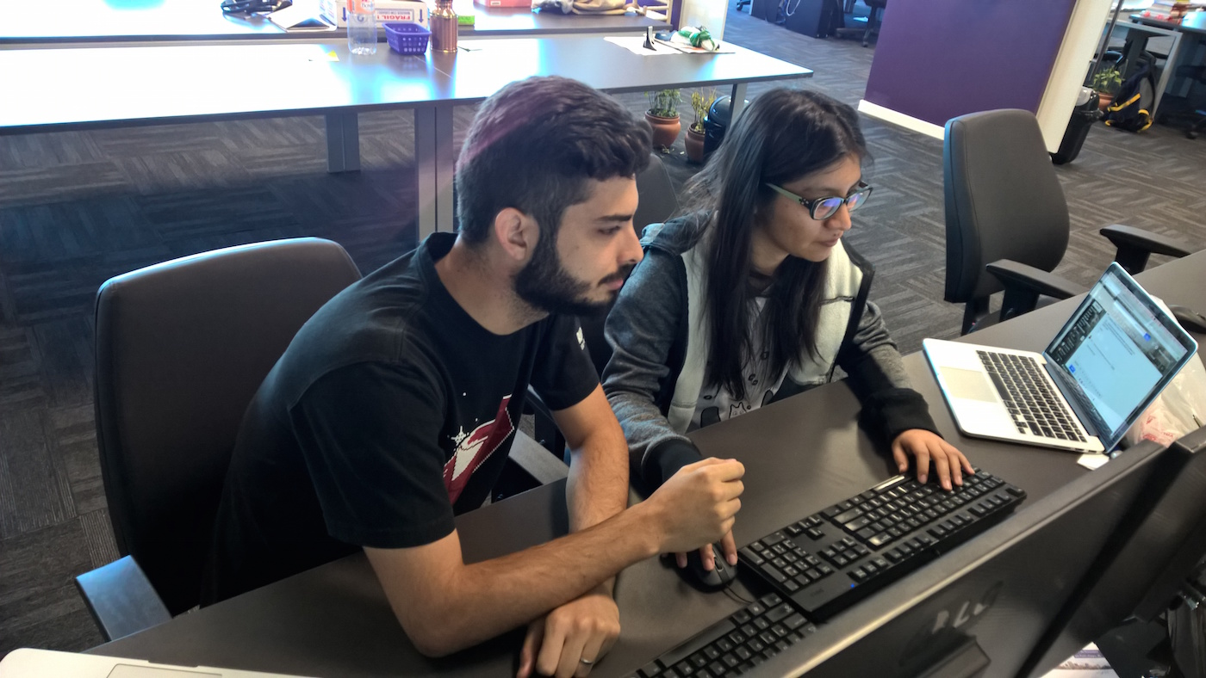
Test Driven
development
API
Blind spots
THOMAS PIERRAIN (@TPIERRAIN)
Notes:
Image : https://insights-images.thoughtworks.com/pairprogramming_f0d3ae7ef121e981e150bfcae4ecb995.jpg

Slide 32
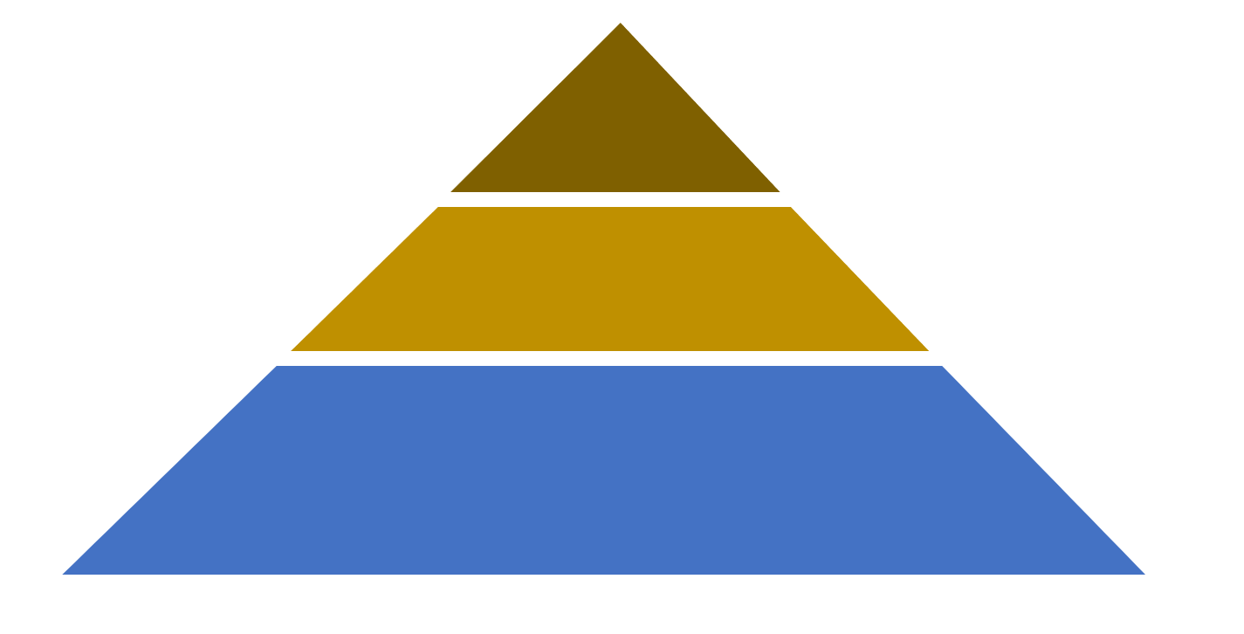


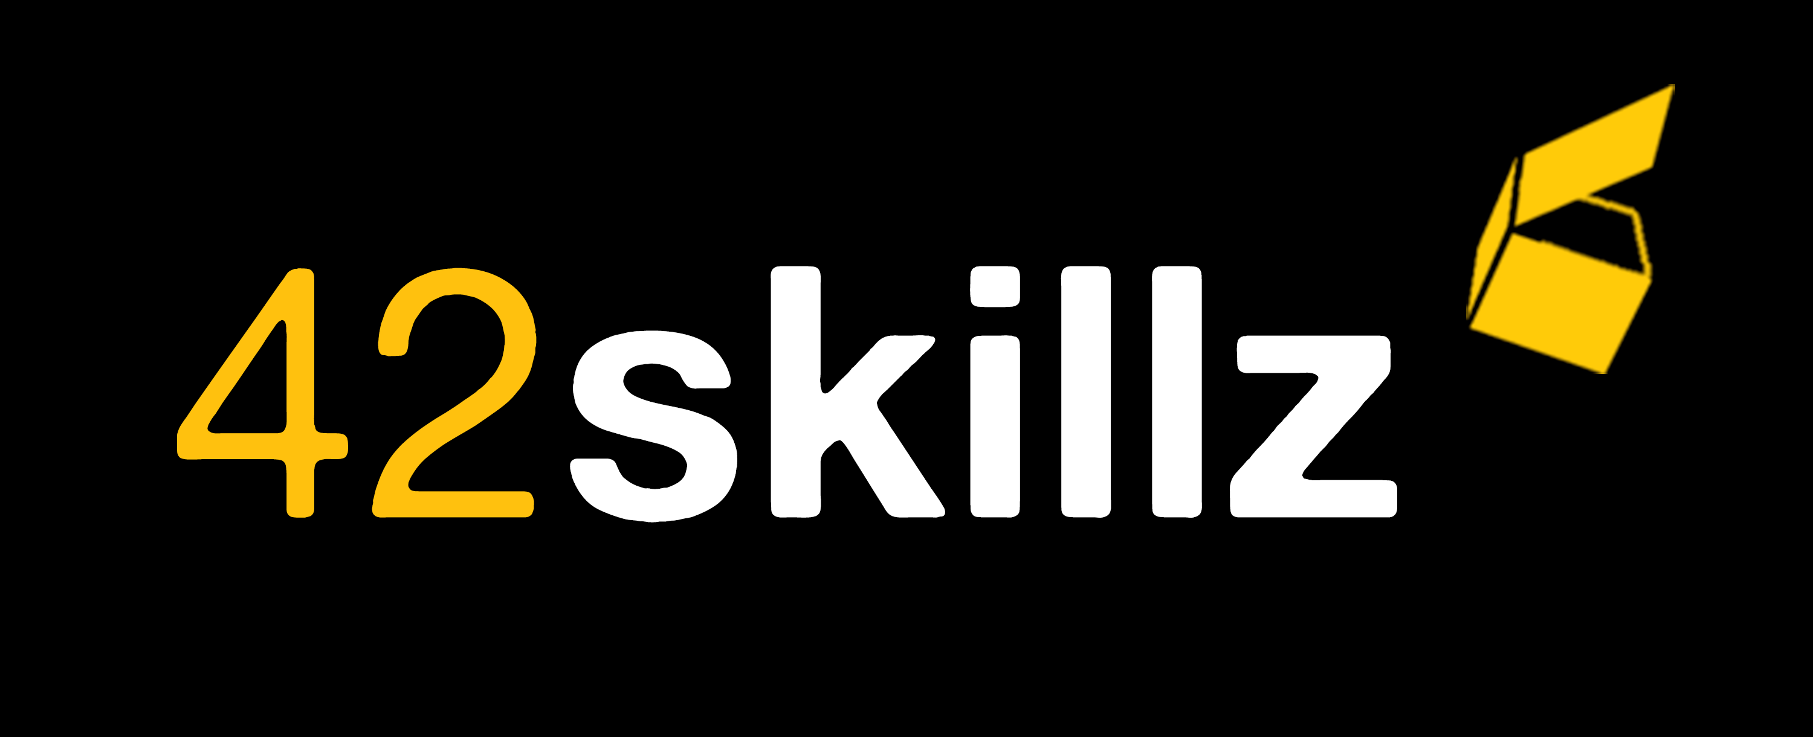
Checking In real life…
All real systems involved May be Manual sometimes
To this
QA
Smoke tests Exploratory tests End-to-end tests
From this
contract tests
Integration tests
Are we still compliant with…?
Some real systems involved
Ensure that Stubs ⬄ Real systems
It all starts here…
Outside-in TDD
Behavioural & Domain-Driven
Bloody Fast
Autonomous & Concise (builders & Fuzzers to setup)
NO I/O ➔ “last miles” stubs
Deterministic & Isolated
The outer loop
Start Here
Acceptance tests
(Coarse-grained “unit” tests)
unit tests
(Fine-grained)
For complex parts only
Behavioural & Domain-Driven
Bloody Fast
Deterministic & Isolated
The inner (optional) loop
testing gem: Why outside-in diamond is now our favorite testing strategy @

Slide 33
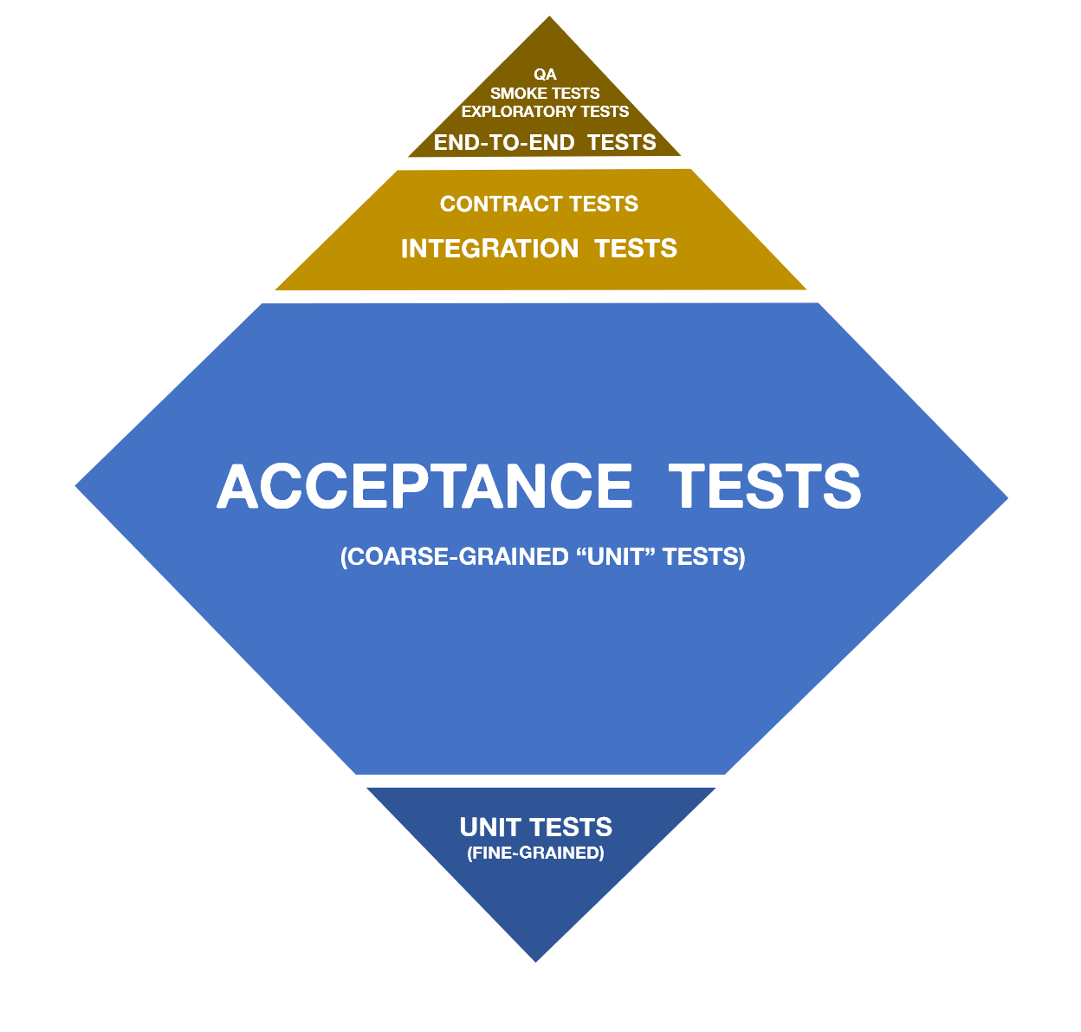
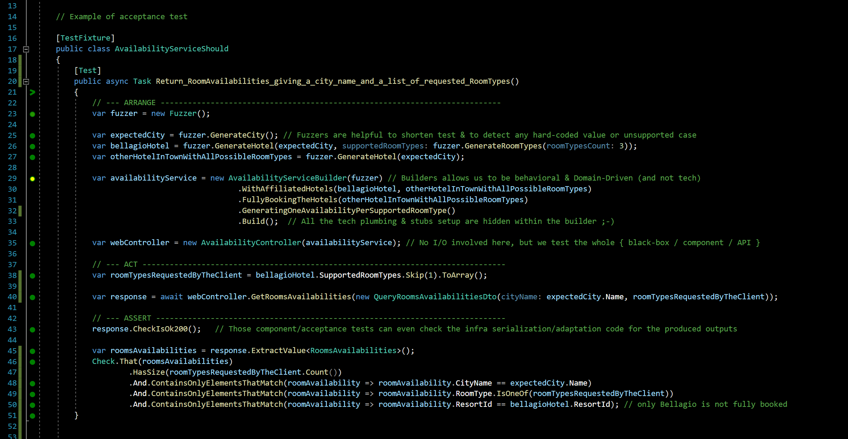
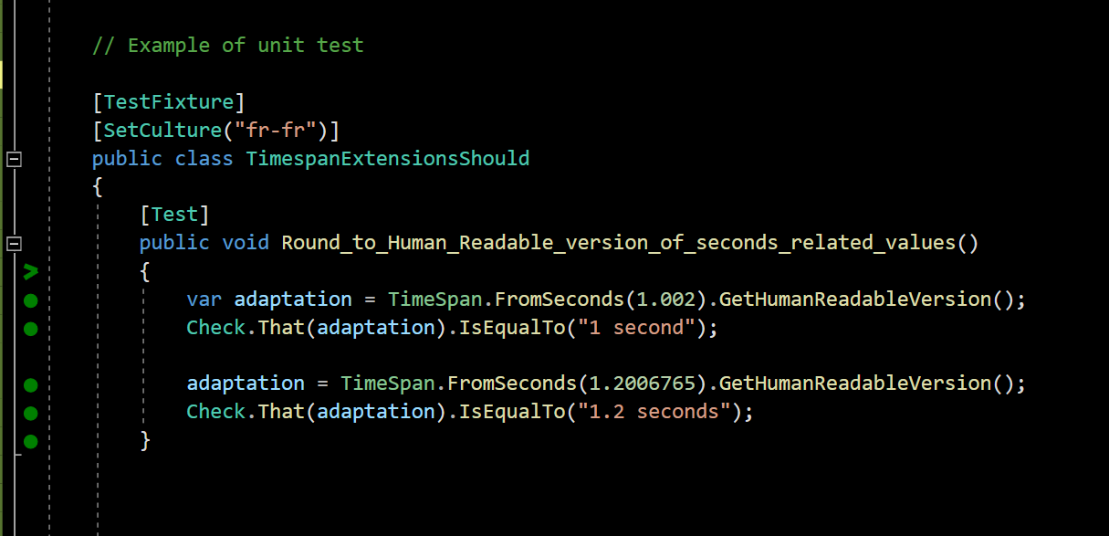
Can you Give me an example?
testing gem: Why outside-in diamond is now our favorite testing strategy @

Slide 34
What you test is what you ship…
No more bad surprises in situation >> everything is tested assembled
no more code plumbing leaks >> Our Acceptance tests cover everything (but I/O)
complementary contract (integration) tests >> A guarantee that the stubs we use to speed our Acceptance tests are faithful to reality
WHY
Easier for Junior DEVs
They are More focused on the system behaviors >> it Enforces Yagni
They code less fragile tests (no more implementation tests) >> it Eases merciless Refactoring
How
Specific Outside-in TDD
Double loop ➔ one and a half loop instead (Fine-grained unit tests only whenever facing difficulties)
Still Baby steps FTW!
only the external systems are stubbed
Acceptance tests cover adapters code too! (only the adaptation code in action, not its I/O)
Behavioural and domain-driven tests (DDD Ubiquitous language)
Blazing-fast acceptance tests
But…
…What about
Combinatory explosion of test cases?!? ➔lots of concise & easy to write acceptance tests (powered by fuzzers) were more than sufficient in 85% of our xp
Surgical identification of bug spots?!? ➔ no big deal actually. very episodically, You just debug your reproductible acceptance test and… TADA! (this point was just cargo-cult psychological barrier)
Friendly patterns & tools
DDD & Hexagonal architecture
Builders & Fuzzers for acceptance tests setup
live-testing tools
Dev people dislike to write enough integration tests (vs. unit ones). This explains lots of Blind Spots & Failures of classical test strategies
➔ We've tradeoff former approaches (UT x IT) in favor of safeness in production whatever the vigilance of the dev team
testing gem: Why outside-in diamond is now our favorite testing strategy @
Notes:
Blind spots of lots of test strategies is due to the fact that dev doesn’t take lot of time to code integration tests (vs. unit ones)
We trade off former approaches (UT x IT) in favor of quietness in production whatever the dev team.
Realizing that We realized that dev took more time to unit test than to integration tests
Dev dedicate a lot more times to unit test than integration tests

Slide 35
Binary is for machine Code is for people We care people
Special thanks to: Cyrille DUPUYDAUBY & Rui CARVALHO for their kind reviews & feedbacks

Slide 37

Notes:
Image: https://miro.medium.com/max/7788/1*0aU36QSwzY0no7XEjoyM7g.jpeg

Slide 38
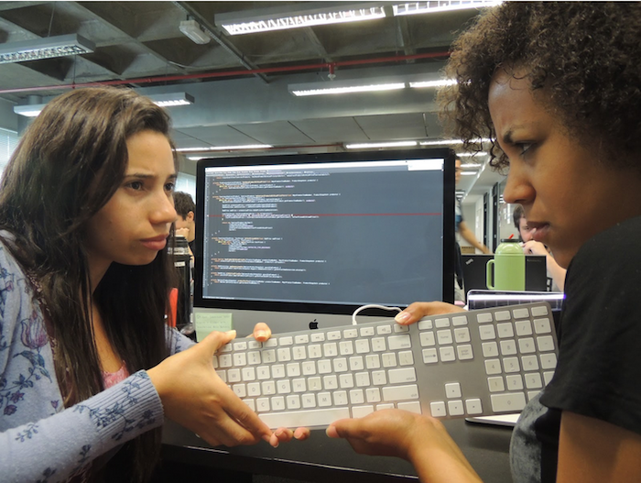
Notes:
Image: https://insights-images.thoughtworks.com/1020ways20pair20programming201_ac7561ab53c005c72dd42a76dcc238a9.png

Slide 39
Outside-in?
Test Driven
development
AT
AT
UT
UT
AT
AT
API
AT
UT
THOMAS PIERRAIN (@TPIERRAIN)
UT
Notes:
Image: https://miro.medium.com/max/13440/1*o7WmwGkLVR0dVQUYqfSBeg.jpeg

